Slide 1
Cathode to the GPU

Slide 2
History of Graphics
CRT
Signal to Pixel
Enter the Matrix
GPU
Shader

Slide 3
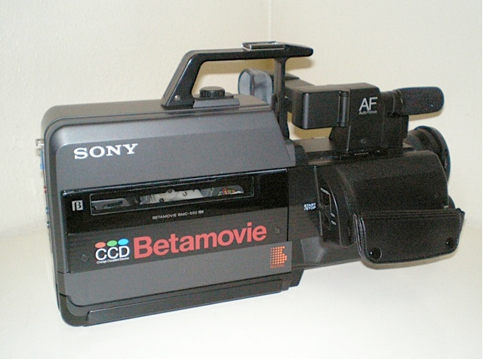
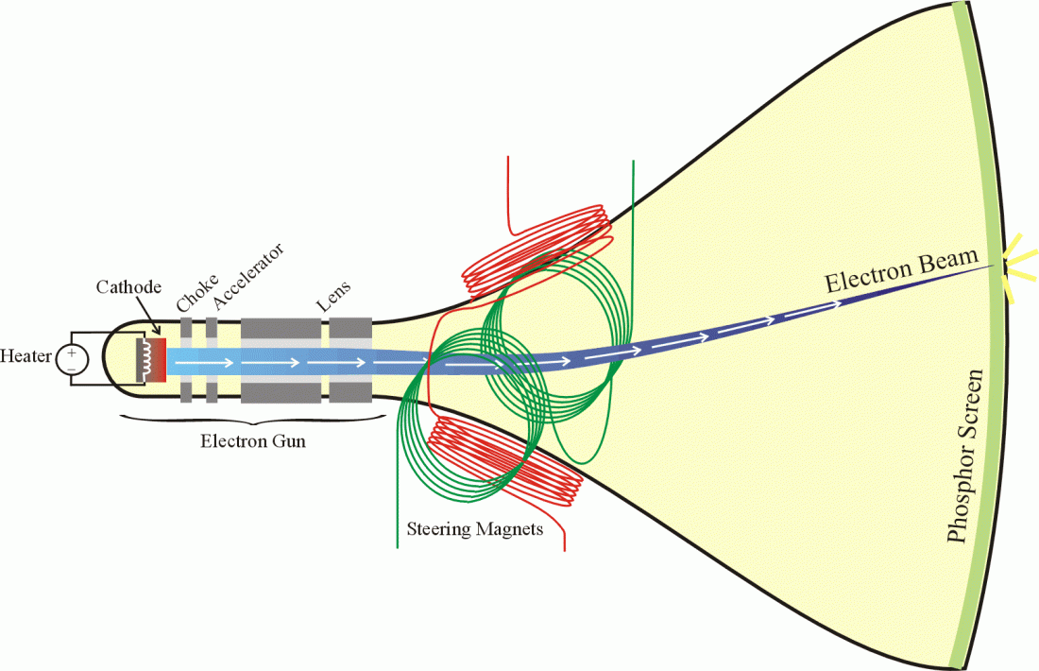

Slide 4
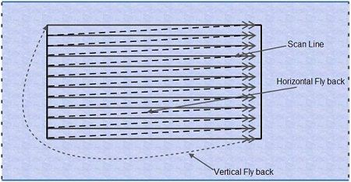

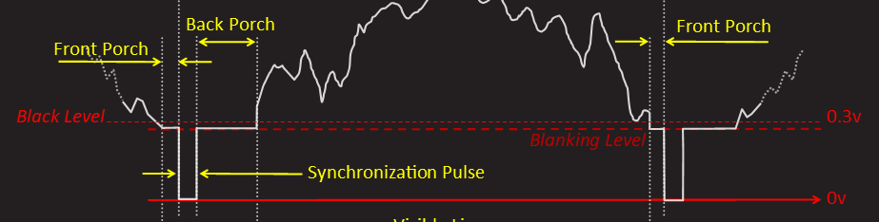
Raster
Scanline Waveform
Composite Waveform
Scanline Signal

Slide 5
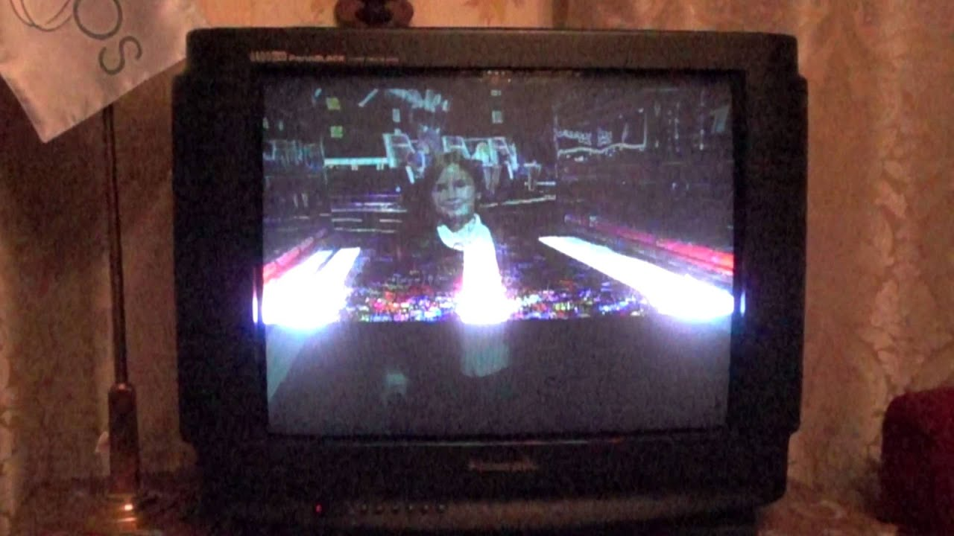

Slide 6
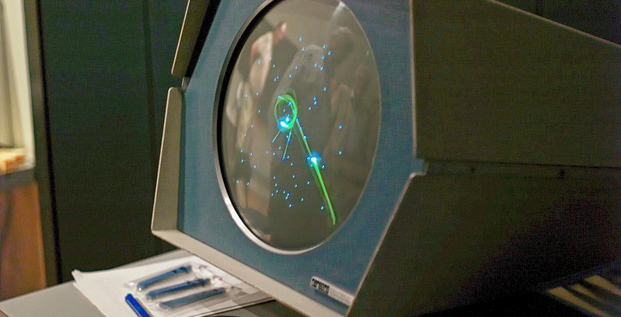

Slide 7
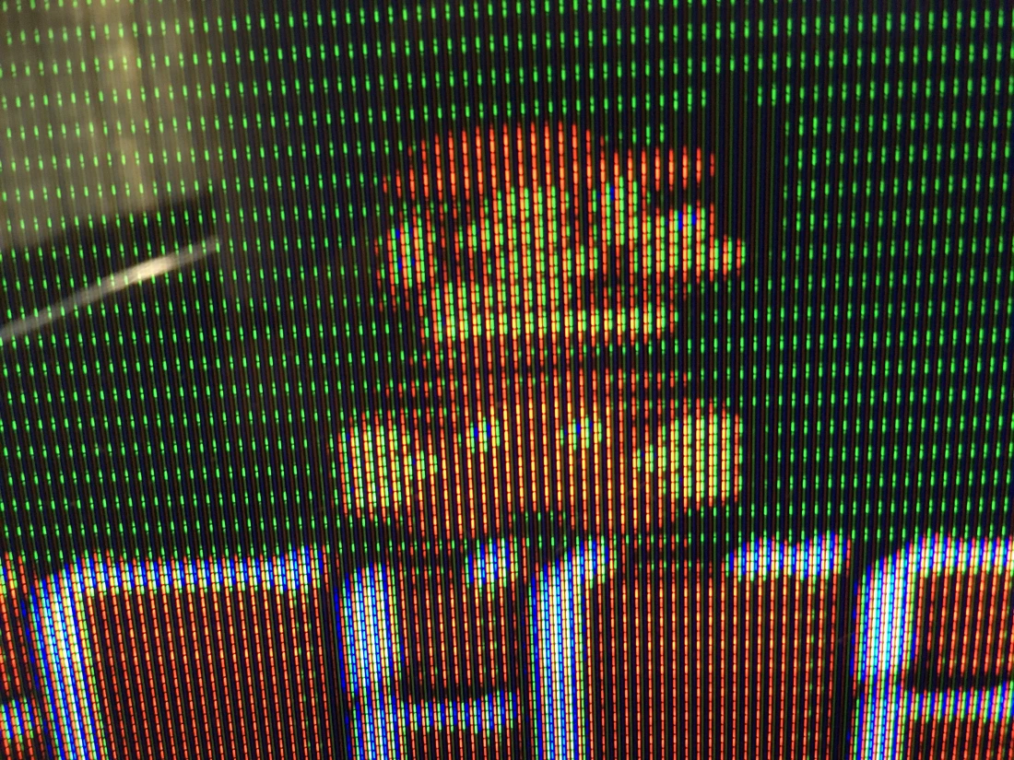
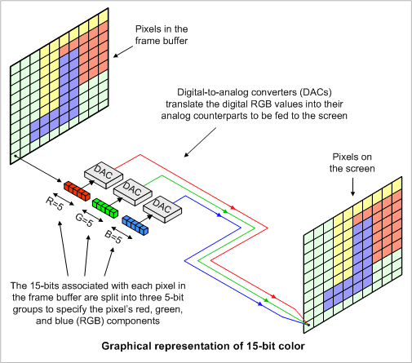
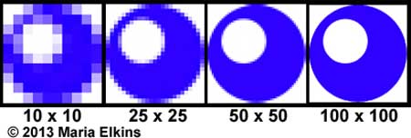
How to Get Pixels to Screen
Frame Buffer -> DAC -> Wire -> Screen

Slide 8
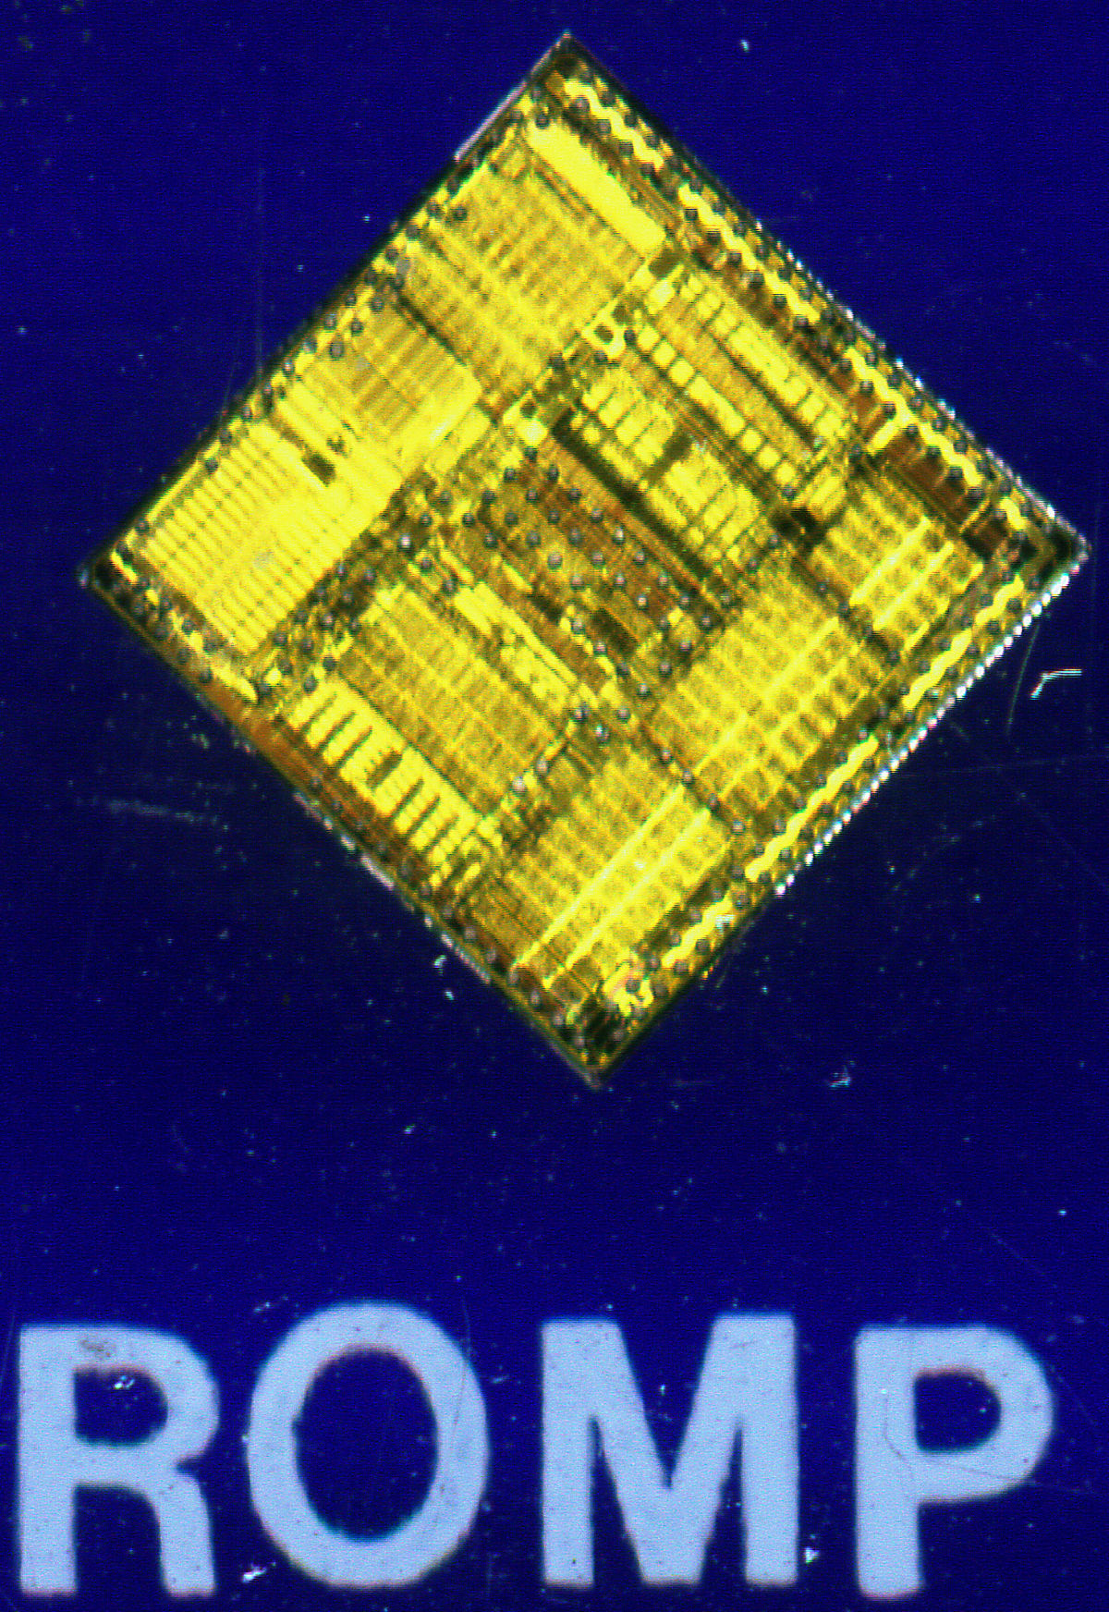
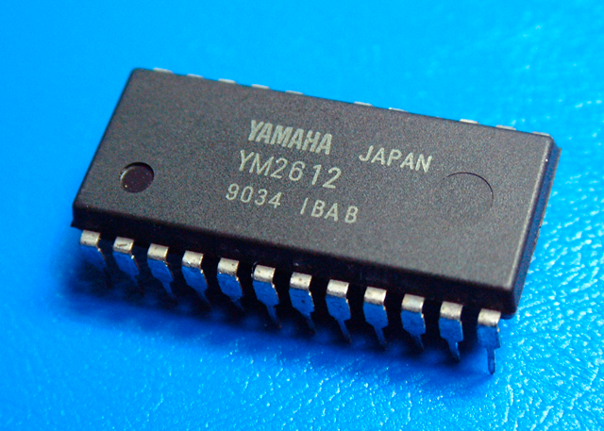
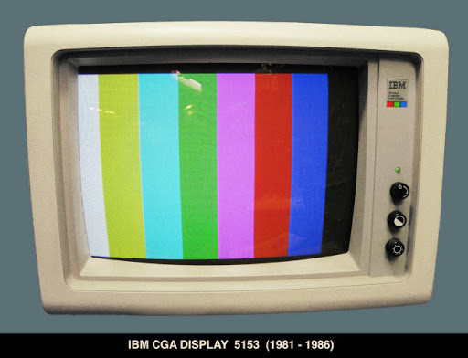
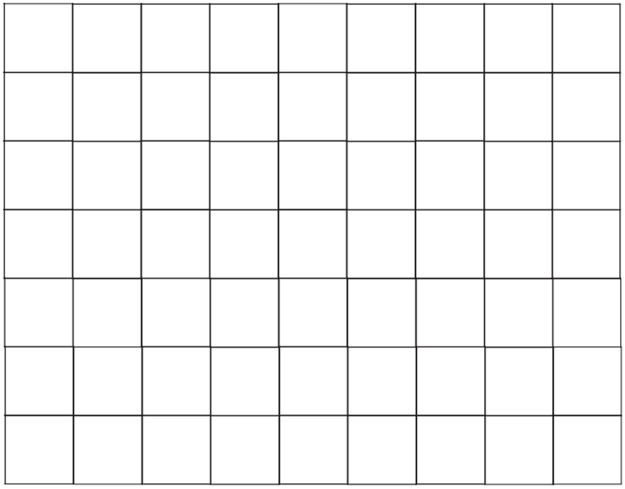
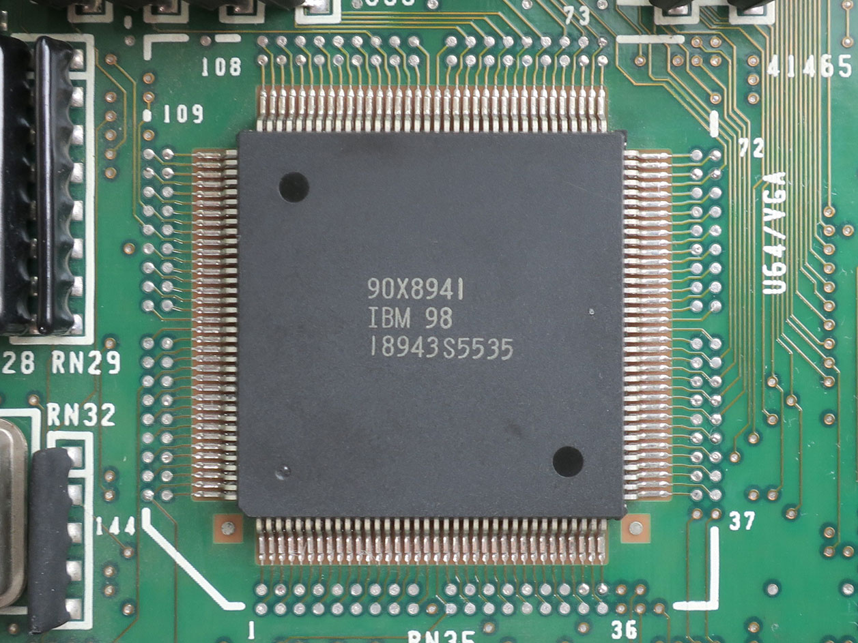
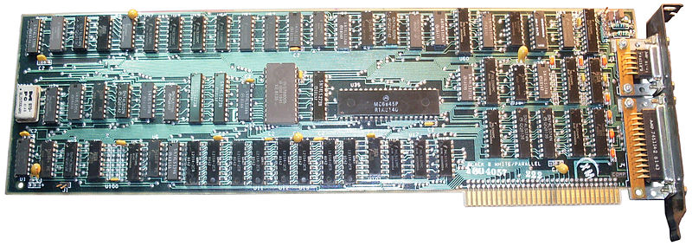
First GPUs
Bytes to Screen

Slide 9
IBM Monochrome Display Adapter
Release 1981, two years before Apple Lisa & GUI
80 by 25 printable characters to screen. (80*25=2000)
Rendered Characters
IBM Color Graphics Adapter
Text modes:
40×25 with 8×8 pixel font (effective resolution of 320×200)
80×25 with 8×8 pixel font (effective resolution of 640×200)
Graphics modes:
640×200 in 2 colors. Pixel aspect ratio of 1:2.4
160×100 16 color mode

Slide 10
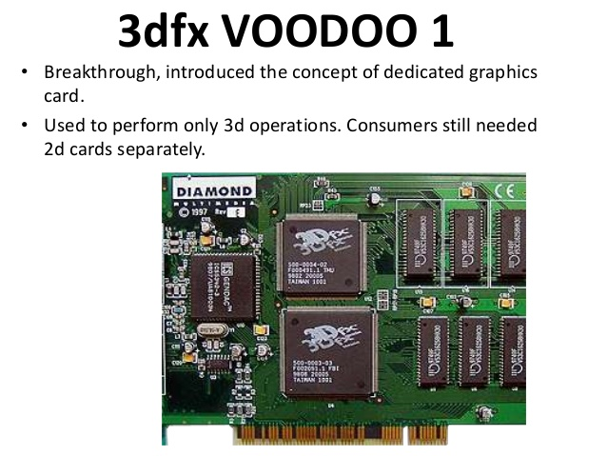
(1996)
Start of Hardware Accelerated Arms Race

Slide 11
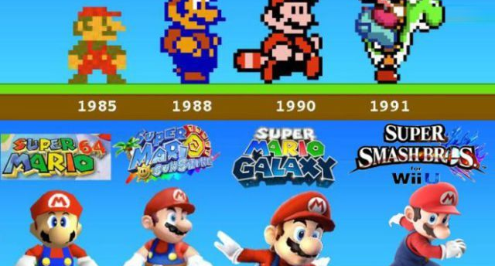

Slide 12
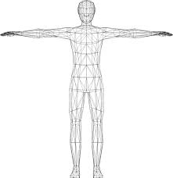
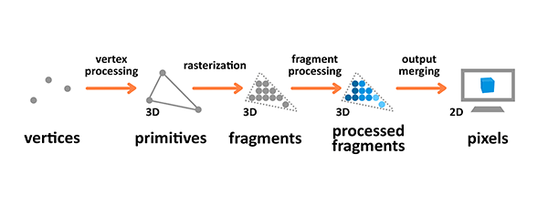
3D Rasterizer

Slide 13
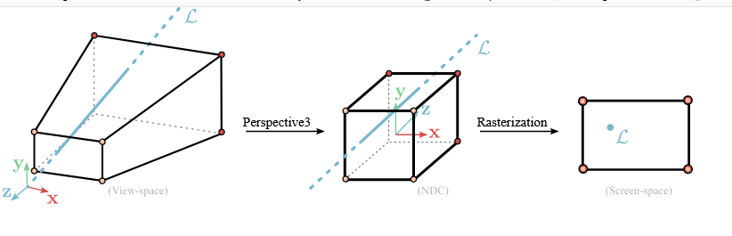
World-Space to Screen-Space

Slide 14
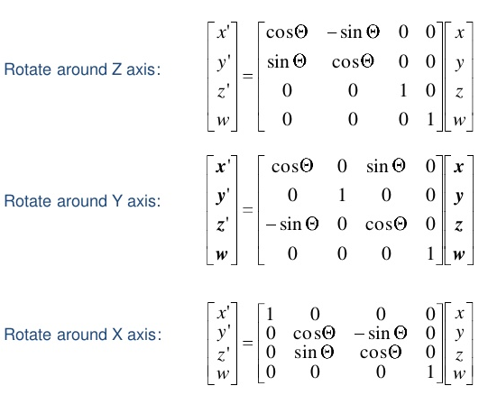
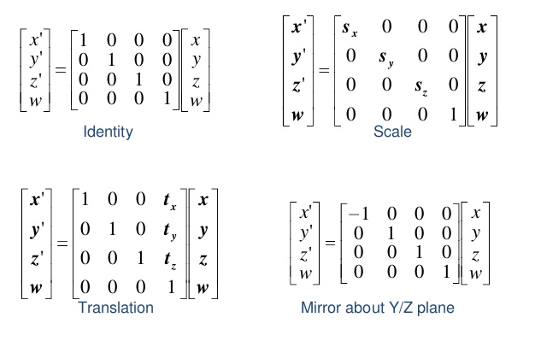
World-Space to Screen-Space

Slide 15
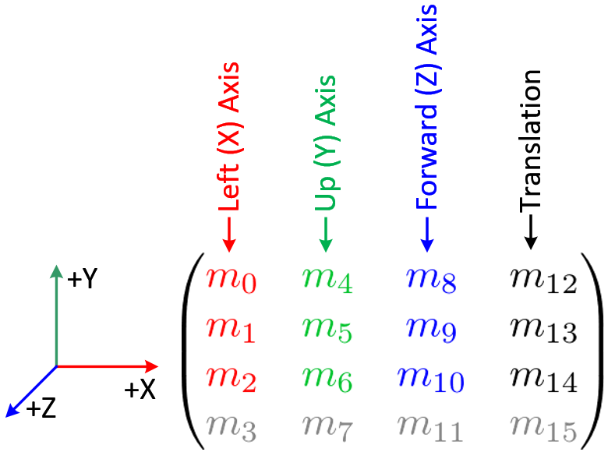
The goals is to combine all 3D math into a single matrix that each vertex can be multiplied by
World-Space to Screen-Space

Slide 16
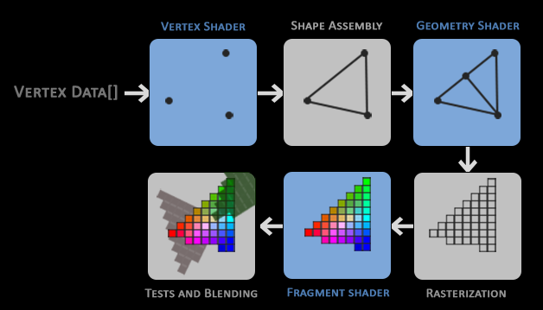
Rendering Pipeline

Slide 17
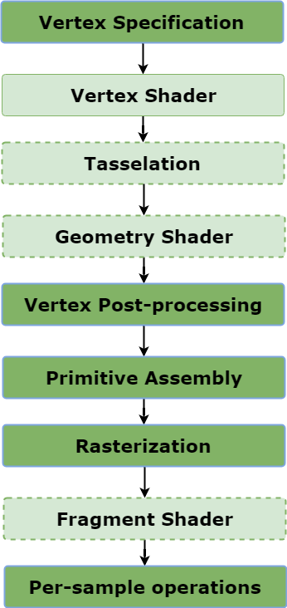
Rendering Pipeline

Slide 18
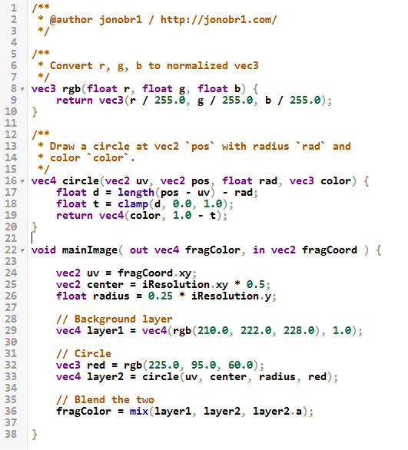


Slide 19
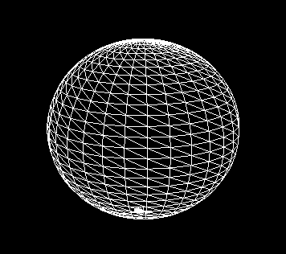
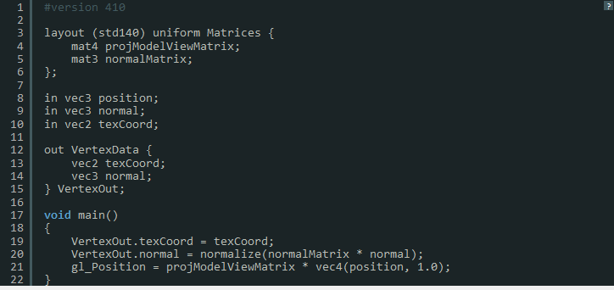

Slide 20
What about lighting?
Lighting is barely supported by existing graphics pipelines.
GPU handle lighting brightness in fragment shader by passing point lights.
These types of lighting are not supported:
Shadows
Volumes
Caustics
Reflections
Refractions
…and much more.
Blinn-Phong Reflection

Slide 21
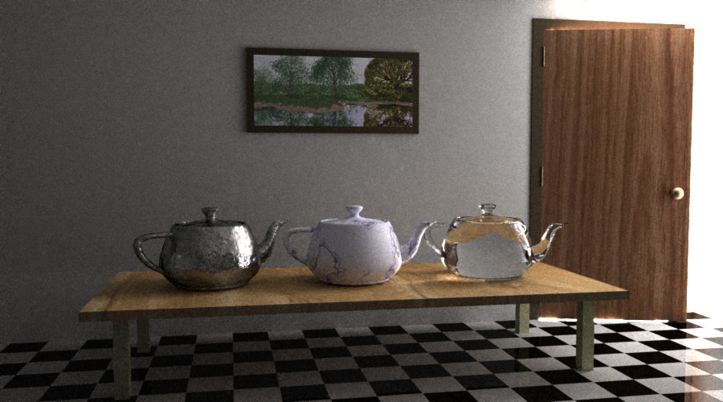
Light Transport

Slide 22
Other Goodies

Slide 23
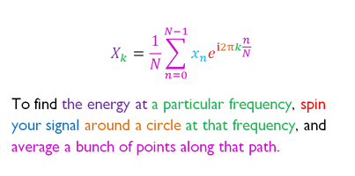
Fourier Transform
Represent anything as a list of frequencies!!!

Slide 24
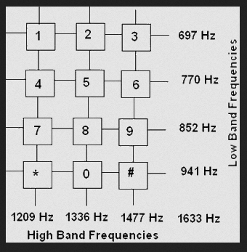

Slide 25
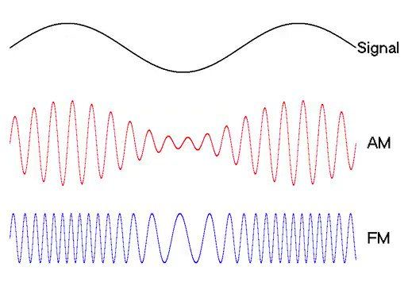

Slide 26
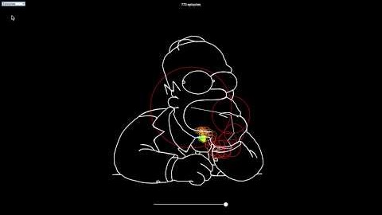
https://www.youtube.com/watch?v=n-43Uje-OuQ

Slide 27
Rendering Mediums

Slide 28
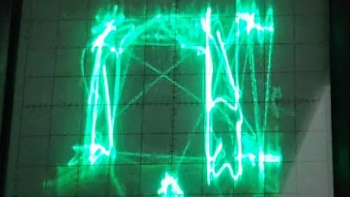

Slide 29
